Slide 1
ABC Case Intro
Presenter: Kirby Rosplock, PhD
Tamarind Partners

Slide 2
Introduction
Purpose of a Learning Case Study
  Genogram
  Complexity
Part I: ABC Family Background
  Abbots
  Bonds
  Canes
Part II: Family Office Considerations
  Family Office Planning
  Structures vs. Start up
  SWOT Analysis
  Appendix
Closing Thoughts

Slide 3
Learning Case Study offers a window…
Peer into another family’s experience
Reflect on what they learned
Relate what is relevant your experience; note: you have an office, you are not building from scratch
Discuss case takeaways and highlights
Identify gaps, questions, or areas for further exploration
Normalize the necessary conversations around change
PURPOSE

Slide 4
FAMILY BACKGROUND
Sale of a family business
Triggers family to contemplate setting up a family office
Proceeds from the sale net to family was $750 million split among three primary branches
  Abbots
  Canes
  Bonds
Beginning of the journey to explore a family office concept
Key considerations: services, complexity, costs, leadership, involvement, and scale
PART I
Notes:
Holistic lens to family member well-being
Services that supports and sustains the lifestyle and complex financial and investment needs
Wealth continuity, integration and control
Owners to have more oversight, control and management of the wealth, estate, and planning
Risk mgt leave
A vehicle to grow family capital
Emphasis on family education, culture, and governance

Slide 5
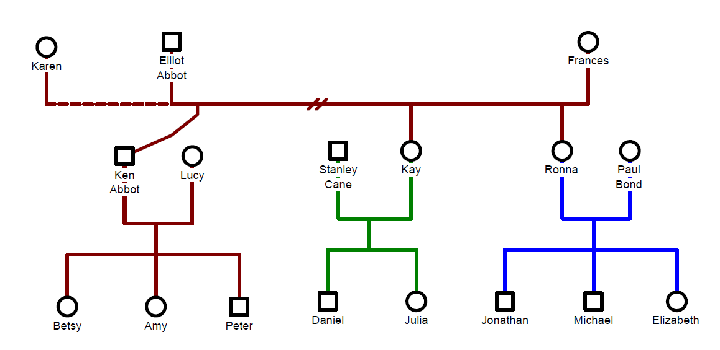
ABC Family Genogram

Slide 6



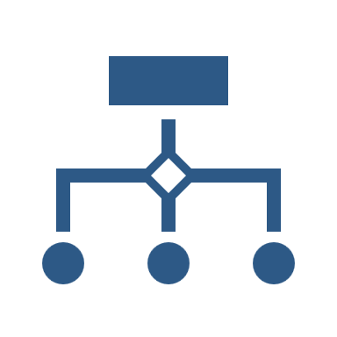

Family Office Complexity
Family
Ownership
Service Types
Service Level

Slide 7



Family Office Complexity
Investments
Structuring
Businesses
Operations

Slide 8
ABBOT FAMILY
Directly involved as leaders in the family business
More entrepreneurial and view themselves as business builders
Cost sensitive and viewed their family needs as least complex
High locus of control
Desire less communication and only quarterly reports
Identified that family services were not a high priority
Potential interest to set up an investment business with proceeds but considering their options carefully
PART I

Slide 9
BOND FAMILY
View the family service needs as more complex
Bond family desires most comprehensive family office services
Less concerned about costs and more concerned about transparency, control, and service level
VERY High locus of control; VERY private and discreet
Desire the MOST communication, reporting, and visibility
Identified that family services were a high priority
Interested to explore opportunities to scale
Desire running investments in-house
PART I

Slide 10
CANES FAMILY
Unsure of what they should do and were not as far along with which model might best apply
Learning more on the outside their options
Unsure about the level of communication and reporting required
Not interested in building out an investment platform
Interested to find alignment and synergy with other possible branches of the family on investments
Did not feel that had the operational know-how to build out an investment business
Viewed their family as less complex than the Bonds
PART I

Slide 11
TABLE DISCUSSION
Describe the different goals, values, and needs of each family branch. How might this influence which family office type is right for them?
What services are most important to which family branches? Describe.
How might the scale, complexity, customization, control, and cost impact the family office design?
What do we know about family members’ involvement and oversight interest with respect to the family office? Describe.
PART I: QUESTIONS

Slide 12
PART II: ABC Family Case Study

Slide 13
FAMILY OFFICE PLANNING
Family conversations were intentional and open around their family office goals
Exploring the “why” they wanted/need an office, what were the specific objectives, and if there was alignment was explored
Different approaches emerged from the dialogue
Transparency of where there was synergies was identified between the Bonds and the Canes
“Buyers” vs. “Builders” also started to emerge
PART II

Slide 14

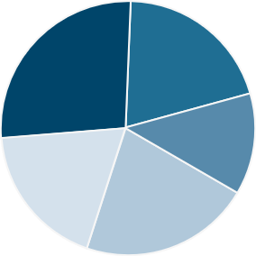
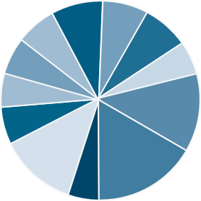
STRUCTURES
Family Office Structures / Evolving Landscape
Virtual Family Office (Coordinator)
Traditional Single Client Family Office
Owner/Manager/Operator
$50 150 million in assets
1-2 Generations
Team of Trusted Outside Advisors
One Family Member or Executive acts as Quarterback
Small staff (1 or 2 people)
Basic Reporting, minimal services
Fully Outsourced
May be a temporary solution.
Formal Structure – LLC, S Corp, Coop
Formal Mission Statement
$250 + Million in Assets ($100 mm minimum)
3+ Generations
Existed for 20+ years.
Dedicated Staff
Basic Systems /Reporting
Mostly In-house and limited outsourced.
Multi-Family Office (Closed End)
Multi-Client Family Office (Commercial)
Multi-family Business Structure
Alignment to Founding Family’s Mission Statement
Min $500 million; typically, $1-2 billion in assets
Fewer Number of Clients
Dedicated Staff
Complete Reporting
In-house and Outsourced
Open architecture
Aligned vision and mission.
For profit Business Structure
No Founding Family
$5+ Billion in Assets
Lesser Concentration of Wealth
Full Menu of Services Provided
Greater Number of Clients
Large Dedicated Staff
Less Customization
Complete Reporting
All in-house
Proprietary Products and/or open architecture
Service agreements
Source modified From BNY Mellon Wealth Management ©2009

Slide 15
Building a SFO can be a major undertaking
  The process can extend over months, even years depending on triggering events and/or family, business tax, ownership.
  and liquidity considerations
Detailed planning is essential to a successful launch
Scope
Design
Prototype
Beta Test Services
Launch & Iterate
Theoretical SFO Start Up Workplan
SFO
START-UP PLAN
Iterative analysis and modeling over time
Source: Modified From EY Family Office Guide. Pathway to Successful Family Wealth Management , 2016

Slide 16
SWOT ANALYSIS
SWOT analysis is a strategic planning technique that provides assessment tools.
Identifying core strengths, weaknesses, opportunities, and threats leads to fact-based analysis, fresh perspectives, and new ideas.
A SWOT analysis pulls information internal sources (strengths of weaknesses of the specific organization) as well as external forces that may have uncontrollable impacts to decisions (opportunities and threats).
SWOT analysis works best when diverse groups or voices within an organization are free to provide realistic data points rather than prescribed messaging.
Findings of a SWOT analysis are often synthesized to support a single objective or decision that an organization is facing.
BACKGROUND

Slide 17
SWOT ANALYSIS
Strengths
Weaknesses
1. What is the competitive advantage?
2. What resources do they have?
3. What are the key attributes?
1. What are the potential pitfalls?
2. Describe the challenges?
3. Where might resources or expertise might be lacking?
Internal
FAMILY OFFICE SWOT
Opportunities
Threats
1. What is new that can aid the family office development?
2. Identify any innovations, technology, scale, etc. that are of interest to the family.
3. What services enhance the family’s well-being?
1. What threats exist to this approach?
2. What could derail the family office model?
3. What might inhibit growth or development of this model?
External

Slide 18
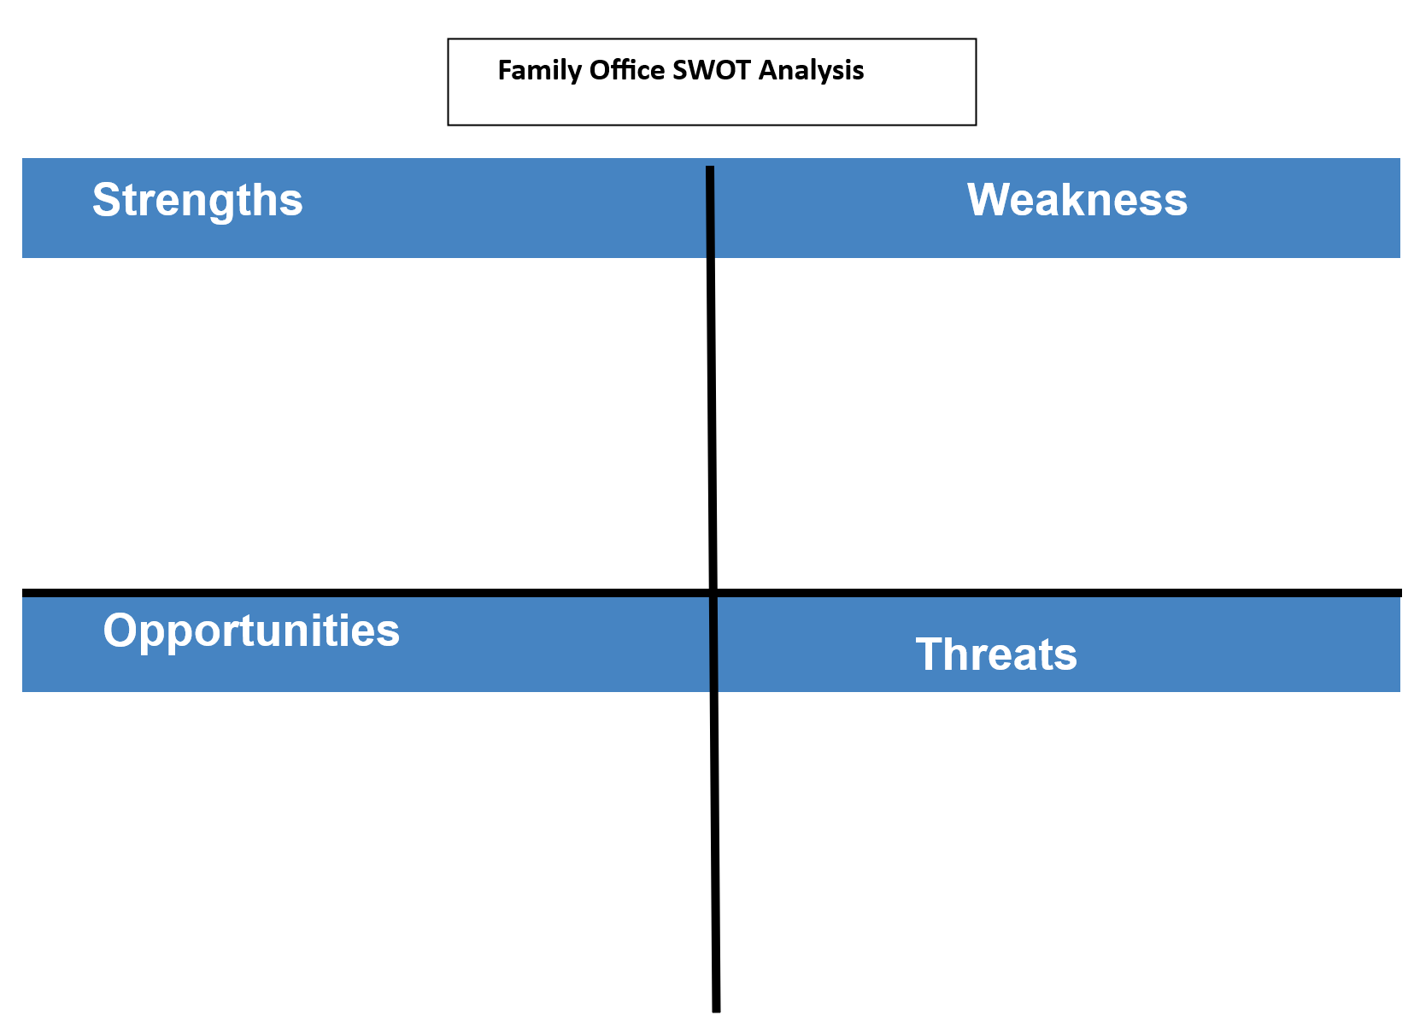
SWOT DISCUSSION

Slide 19
Strengths, Weaknesses, Opportunities & Threats Analysis (SWOT)
Single-Family Office SWOT Analysis
Strengths
Weakness
Control
Customized, dedicated service
Privacy and anonymity
Alignment and integration
No SFO competition
Patient capital
Wealth preservation
Family first
Attracting and retaining talent
Cost controls
Access to products and services
Operational efficiencies
Service level inadequacies
Bridging family continuity
Urgency toward strategic planning
Opportunities
Threats
Open architecture
Co-investments
First-class service
Collaboration
Sharing and streamlining costs
Peer-to-peer exchange
SFO best practice information and research
Managing scope
Controlling costs
Compensation challenges
Generational mathematics
Family conflict
Succession planning
Keeping family on-board
Source: Rosplock, K., The Complete Family Office Handbook: A Guide For Affluent Families And The Advisors Who Serve Them, 2014, page 56

Slide 20
Strengths
Strengths, Weaknesses, Opportunities & Threats Analysis (SWOT)
Multi-Family Office SWOT Analysis
Weakness
Scale
Comprehensive services
Streamlined and efficient integration
Breadth of resources
Top talent and retention
Centralized data management
Client/Advisor load (+/-)
Institutionalize service offering
Access to products and services
Group-think
Customization or personalization
Bureaucracy
Opportunities
Threats
More for less
Learning curve
Open architecture
“One-stop shop”
Sharing costs for specialty services
Access to investment managers, products, and research
Thought leadership and innovation
Getting too big, too fast
Maintaining close relationships
Overpromising
Talent retention and turnover
Ownership and leadership alignment
Corporate culture
Source: Rosplock, K., The Complete Family Office Handbook: A Guide For Affluent Families And The Advisors Who Serve Them, 2014, page 56

Slide 21
TO BUILD OR TO BUY
PROS BUILD
PROS BUY
Highest level of privacy and confidentiality
Long-term personnel retention
Personnel with insider knowledge
Systems, policies, and procedures customized to family’s needs
Greatest opportunity for hands-on family involvement
Specialized, top-notch personnel
Access to shared technology, techniques, or tools that might not be affordable or feasible on own
Client best practice knowledge applied to guide the family
Cleary-defined scope of services
INSOURCE VS OUTSOURCE
CONS BUILD
CONS BUY
Less agile in building capacity or downsizing
Steep learning curves or resistance to change by staff
Keeping current with technology and skills can be challenging - systems, financial investments, accounting, tax
Updating and maintaining
Higher turnover
Outsourced staffing costs may be higher
Family may be pressured to use the operators’ preferred methods
Outsourced professionals may feel less accountable or committed
Rollups or changes in ownership
Notes:
PROS BUILD
Highest level of privacy and confidentiality
Long-term personnel retention
Personnel with insider knowledge
Systems, policies, and procedures customized to family’s needs
Greatest opportunity for hands-on family involvement
PROS BUY
Specialized, top-notch personnel
Access to shared technology, techniques, or tools that might not be affordable or feasible on own
Client best practice knowledge applied to guide the family
Cleary-defined scope of services
CONS BUILD
Less agile in building capacity or downsizing
Steep learning curves or resistance to change by staff
Keeping current with technology and skills can be challenging - systems, financial investments, accounting, tax
Updating and maintaining
CONS BUY
Higher turnover
Outsourced staffing costs may be higher
Family may be pressured to use the operators’ preferred methods
Outsourced professionals may feel less accountable or committed
Rollups or changes in ownership

Slide 22
TABLE DISCUSSION
Discuss and answer the following questions and complete a SWOT analysis for one family.
Bonds: Which family office structure did they select? What were their goals with this type of family office? What did they learn about the process of setting up their office? Why was this the best decision for their family?
Canes: Which family office structure did they select? What were their goals with this type of family office? What did they decide to do with their investments? What were the benefits of approaching their investments this way? How do you think their investment approach impacted their relationship with the Bond family branch?
Abbots: Which family office structure did they initially select? What were their goals with this type of family office? Why did they decide to set up an RIA with Roger? What was it like to work with his business partner Roger? How did Lucy and Ken working together affect their marriage? Do you think they would go down this same path if they could do it all over again?
PART II: QUESTIONS

Slide 23
TABLE DISCUSSION
The Bond, Cane, and Abbot families determine they need different approaches for their family office needs.
What are one or two takeaways from this case study that might apply to your family?
What surprised you or caught your attention? Why? Describe.
PART II: QUESTIONS

Slide 24
STRUCTURES
Family Office Structures / Evolving Landscape
Virtual Family Office (Coordinator)
Traditional Single Client Family Office
Owner/Manager/Operator
$50 150 million in assets
1-2 Generations
Team of Trusted Outside Advisors
One Family Member or Executive acts as Quarterback
Small staff (1 or 2 people)
Basic Reporting, minimal services
Fully Outsourced
May be a temporary solution.
Formal Structure – LLC, S Corp, Coop
Formal Mission Statement
$250 + Million in Assets ($100 mm minimum)
3+ Generations
Existed for 20+ years.
Dedicated Staff
Basic Systems /Reporting
Mostly In-house and limited outsourced.
Multi-Family Office (Closed End)
Multi-Client Family Office (Commercial)
Multi-family Business Structure
Alignment to Founding Family’s Mission Statement
Min $500 million; typically, $1-2 billion in assets
Fewer Number of Clients
Dedicated Staff
Complete Reporting
In-house and Outsourced
Open architecture
Aligned vision and mission.
For profit Business Structure
No Founding Family
$5+ Billion in Assets
Lesser Concentration of Wealth
Full Menu of Services Provided
Greater Number of Clients
Large Dedicated Staff
Less Customization
Complete Reporting
All in-house
Proprietary Products and/or open architecture
Service agreements
Source modified From BNY Mellon Wealth Management ©2009

Slide 25
CASE TAKEAWAYS
Engagement of family members to the planning conversations pivotal
Mapping complexity key and SPL will evolve too over time
Appreciating where family goals align and where they are different
Identify hot button topics and issues that are sensitive
Normalizing conversations that highlight differences and potentially difficult conversations productively
Planning considerations will evolve but having a process to support change is critical
Closing Thoughts

