Slide 1
Family Office Ecosystems
Presenter: Kirby Rosplock, PhD
Tamarind Partners

Slide 2
Managing Complex Change
  3 Themes
Family Office Overview
  Goals
Services
Complexity
Structures
  Setup
  Types
  SWOTs
Build vs. Buy
  Pricing
  Metrics
Closing Thoughts

Slide 3
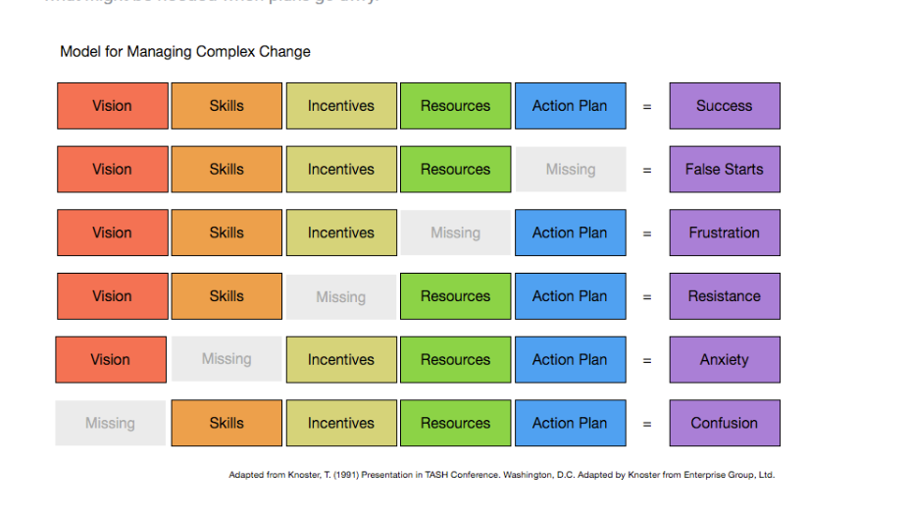

Slide 4
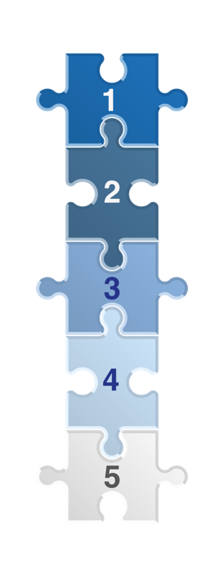
COMMON
GOALS
1
Support family members with their investment, financial and lifestyle needs
Dedicated family office services that support holistically the complex lives of family
Wealth Continuity, Integration and Control
Continuation of the wealth through strategic planning and setting milestones to enhance oversight
Risk Management and Security
Lifestyle protection, personal and cyber security
Family Governance and Communication
Creating a decision-making structure to foster strong family communication and transparency
A Vehicle to Educate and Grow Family Capital
Emphasis on family education, culture and developing human capital
2
3
4
5
Notes:
Holistic lens to family member well-being
Services that supports and sustains the lifestyle and complex financial and investment needs
Wealth continuity, integration and control
Owners to have more oversight, control and management of the wealth, estate, and planning
Risk mgt leave
A vehicle to grow family capital
Emphasis on family education, culture, and governance

Slide 5
Family Office Mandate:
Provide estate planning recommendations
Develop family wealth plans
Support trustees in fiduciary responsibilities
Identify financial resources and objectives
Develop intergenerational wealth transfer plans
Coordinate with professional advisors
Prioritize and facilitate information flow
Trust & Estate Service
Strategic Wealth Management
Investment Planning
Provide customized advisory
Monitor investment performance
Provide comprehensive performance reporting
Participate in manager selection
FAMILY MEMBERS
Impact Investing
Family
Succession & Leadership
Tax & Financial Planning
Develop tax efficient strategies
Oversee personal and entity tax returns
Review personalized financial plans with client
Support family with impact investing
Develop and administer Sustainable Investment Working Group

Slide 6
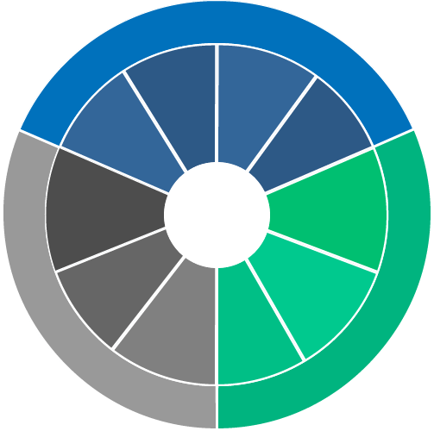
Family Office Services
Family
Financial Planning
Trust &
Estate
Planning
Governance/
Communication
Philanthropic
Management
Wealth/Inv.
Management
Family
Office
Front/Back Office Admin.
Taxation/Asset Protection
Stakeholder
Reporting
Strategic
Family Advisory Board
Operational
Operations/
Compliance

Slide 7





Family Office Complexity
Family
Ownership
Service Types
Service Level

Slide 8



Family Office Complexity
Investments
Structuring
Businesses
Operations

Slide 9
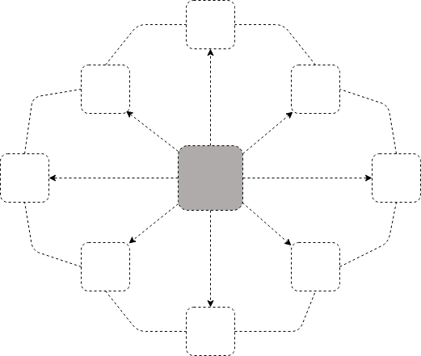
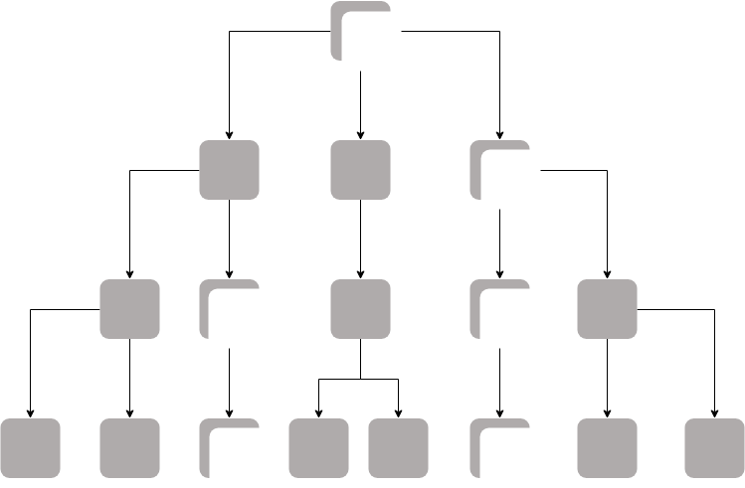
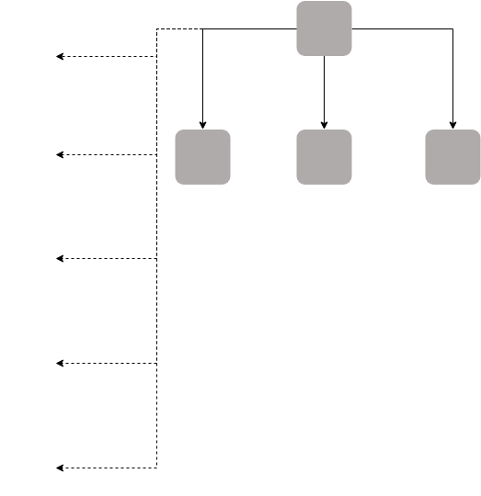

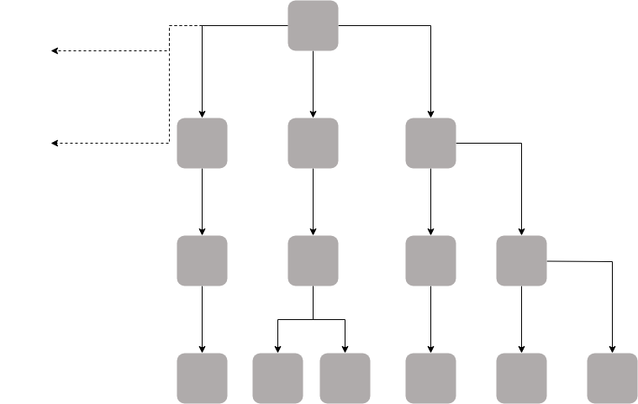
Family Office Structures
Evolving Landscape
Virtual Family Office
Single Family Office (Embedded)
Enterprising
Single Family Office (Outsourced)
Family
Single Family Office (Built-Out)
Single Family Office - Outsourced
Interested in designing FO structure
Want to oversee the big picture but rely on external professional SMEs
Virtual Family Office
Investing
Single Family Office (Outsourced)
Single Family Office – Built-Out
Interested in designing FO structure
Wants control and direct involvement in management
Strong legacy, long term orientation
Single Family Office (Built-Out)
Source: © 2019 Tamarind Partners, Inc.

Slide 10

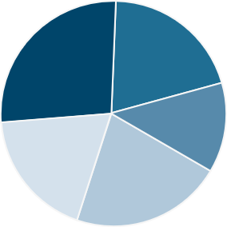
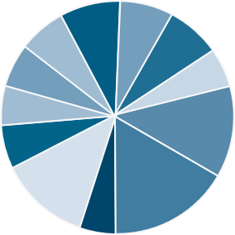
PATHWAYS TO A FAMILY OFFICE
Family Office Structures / Evolving Landscape
Virtual Family Office (Coordinator)
Traditional Single Client Family Office
Owner/Manager/Operator
$50 150 million in assets
1-2 Generations
Team of Trusted Outside Advisors
One Family Member or Executive acts as Quarterback
Small staff (1 or 2 people)
Basic Reporting, minimal services
Fully Outsourced
May be a temporary solution.
Formal Structure – LLC, S Corp, Coop
Formal Mission Statement
$250 + Million in Assets ($100 mm minimum)
3+ Generations
Existed for 20+ years.
Dedicated Staff
Basic Systems /Reporting
Mostly In-house and limited outsourced.
Multi-Family Office (Closed End)
Multi-Client Family Office (Commercial)
Multi-family Business Structure
Alignment to Founding Family’s Mission Statement
Min $500 million; typically, $1-2 billion in assets
Fewer Number of Clients
Dedicated Staff
Complete Reporting
In-house and Outsourced
Open architecture
Aligned vision and mission.
For profit Business Structure
No Founding Family
$5+ Billion in Assets
Lesser Concentration of Wealth
Full Menu of Services Provided
Greater Number of Clients
Large Dedicated Staff
Less Customization
Complete Reporting
All in-house
Proprietary Products and/or open architecture
Service agreements
Source modified From BNY Mellon Wealth Management ©2009

Slide 11
Building a SFO can be a major undertaking
  The process can extend over months, even years depending on triggering events and/or family, business tax, ownership.
  and liquidity considerations
Detailed planning is essential to a successful launch
Scope
Design
Prototype
Beta Test Services
Launch & Iterate
Theoretical SFO Start Up Workplan
SFO
START-UP PLAN
Iterative analysis and modeling over time
Source: Modified From EY Family Office Guide. Pathway to Successful Family Wealth Management , 2016

Slide 12
PATHWAYS TO A FAMILY OFFICE
Family Office Structures / Evolving Landscape
Virtual Family Office
Owner/Manager/Operator
$50 150 million in assets
1-2 Generations
Team of Trusted Outside Advisors
One Family Member or Executive acts as Quarterback
Small staff (1 or 2 people)
Basic Reporting, minimal services
Fully Outsourced
May be a temporary solution.
Source modified From BNY Mellon Wealth Management ©2009

Slide 13
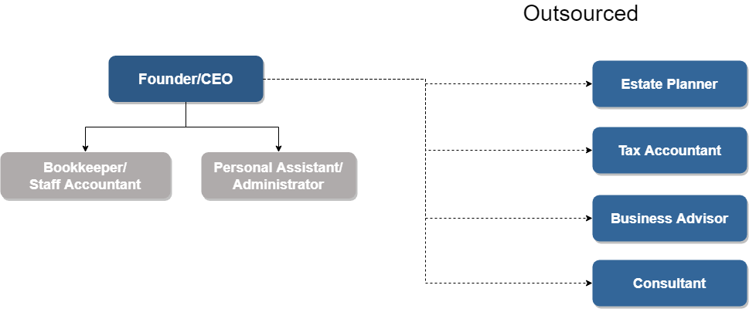
Virtual Family Office (EXAMPLE)
Outsourced
Founder/CEO
Bookkeeper/ staff accountant
Personal Assistant/ Administrator
Investments
Tax and Accounting
Reporting
Technology
Business Consultant

Slide 14
PATHWAYS TO A FAMILY OFFICE
Family Office Structures / Evolving Landscape
Single Family Office
Formal Structure – LLC, S Corp, Coop
Formal Mission Statement
$250 + Million in Assets ($100 mm minimum)
3+ Generations
Existed for 20+ years.
Dedicated Staff
Basic Systems /Reporting
Mostly In-house and limited outsourced.

Slide 15
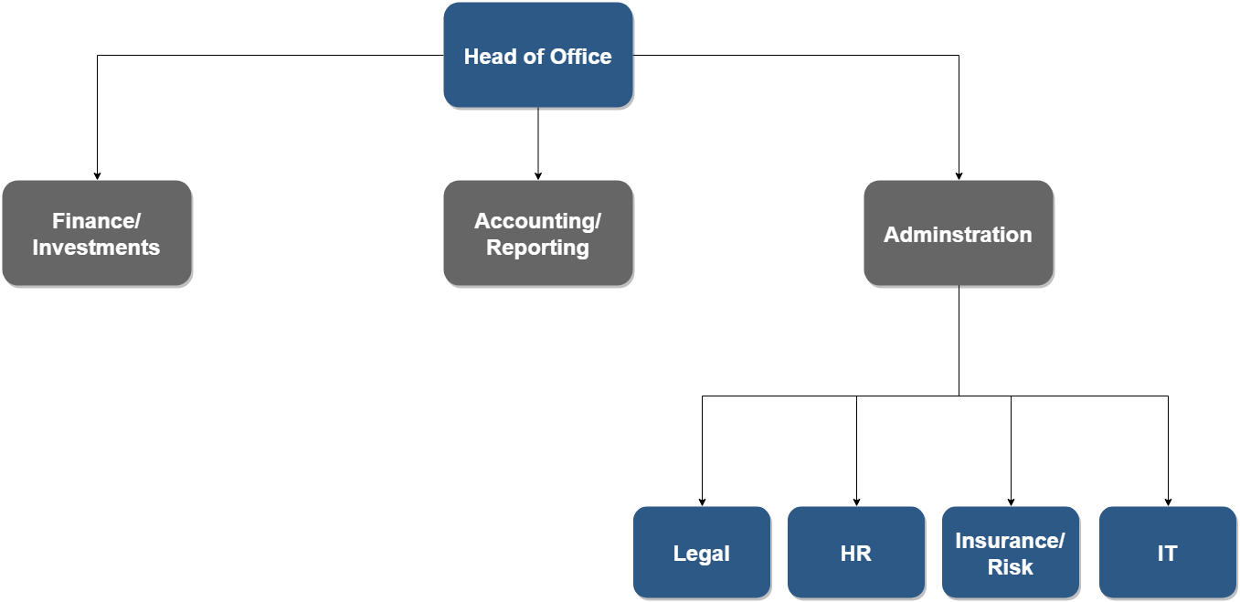
Single Family Office – Built Out (EXAMPLE)
CEO/COO/
Director
Exec. Admin
Investments
Family Services
Legal
Operations
Administration & Accounting
Contracts
Support Services
Portfolio Mgt.
Finance
Reporting

Slide 16
Strengths, Weaknesses, Opportunities & Threats Analysis (SWOT)
Single-Family Office SWOT Analysis
Strengths
Weakness
Control
Customized, dedicated service
Privacy and anonymity
Alignment and integration
No SFO competition
Patient capital
Wealth preservation
Family first
Attracting and retaining talent
Cost controls
Access to products and services
Operational efficiencies
Service level inadequacies
Bridging family continuity
Urgency toward strategic planning
Opportunities
Threats
Open architecture
Co-investments
First-class service
Collaboration
Sharing and streamlining costs
Peer-to-peer exchange
SFO best practice information and research
Managing scope
Controlling costs
Compensation challenges
Generational mathematics
Family conflict
Succession planning
Keeping family on-board
Source: Rosplock, K., The Complete Family Office Handbook: A Guide For Affluent Families And The Advisors Who Serve Them, 2014, page 56

Slide 17
PATHWAYS TO A FAMILY OFFICE
Family Office Structures / Evolving Landscape
Multi-Family Office (Closed)
Multi-family Business Structure
Alignment to Founding Family’s Mission Statement
Min $500 million; typically, $1-2 billion in assets
Fewer Number of Clients
Dedicated Staff
Complete Reporting
In-house and Outsourced
Open architecture
Aligned vision and mission.

Slide 18
PATHWAYS TO A FAMILY OFFICE
Family Office Structures / Evolving Landscape
Multi-Client Family Office (Commercial)
For profit Business Structure
No Founding Family
$5+ Billion in Assets
Lesser Concentration of Wealth
Full Menu of Services Provided
Greater Number of Clients
Large Dedicated Staff
Less Customization
Complete Reporting
All in-house
Proprietary Products and/or open architecture
Service agreements

Slide 19
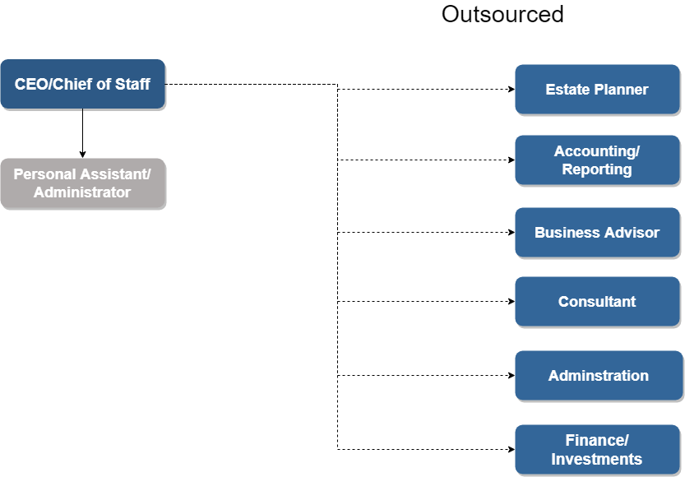
Single Family Office – Outsourced (EXAMPLE)
Outsourced
Investments
Tax and Accounting
Reporting
Technology
Administration
Financial Planning
Concierge Services
Chief of Staff /Founder/CEO
Personal Assistant/ Administrator

Slide 20
Four Types of Commercial Multi-Family Offices
Institutional
Outsourced CIO
Part of an institution - may be
branded or a department within the institution
Investment services only
MULTI-FAMILY OFFICE
TYPES
Independent
Service Provider
Full service MFO including investment services
Wide range of non-investment services such as accounting, legal, tax and trusts

Slide 21
Strengths
Strengths, Weaknesses, Opportunities & Threats Analysis (SWOT)
Multi-Family Office SWOT Analysis
Weakness
Scale
Comprehensive services
Streamlined and efficient integration
Breadth of resources
Top talent and retention
Centralized data management
Client/Advisor load (+/-)
Institutionalize service offering
Access to products and services
Group-think
Customization or personalization
Bureaucracy
Opportunities
Threats
More for less
Learning curve
Open architecture
“One-stop shop”
Sharing costs for specialty services
Access to investment managers, products, and research
Thought leadership and innovation
Getting too big, too fast
Maintaining close relationships
Overpromising
Talent retention and turnover
Ownership and leadership alignment
Corporate culture
Source: Rosplock, K., The Complete Family Office Handbook: A Guide For Affluent Families And The Advisors Who Serve Them, 2014, page 56

Slide 22
TO BUILD OR TO BUY
PROS BUILD
PROS BUY
Highest level of privacy and confidentiality
Long-term personnel retention
Personnel with insider knowledge
Systems, policies, and procedures customized to family’s needs
Greatest opportunity for hands-on family involvement
Specialized, top-notch personnel
Access to shared technology, techniques, or tools that might not be affordable or feasible on own
Client best practice knowledge applied to guide the family
Cleary-defined scope of services
INSOURCE VS OUTSOURCE
CONS BUILD
CONS BUY
Less agile in building capacity or downsizing
Steep learning curves or resistance to change by staff
Keeping current with technology and skills can be challenging - systems, financial investments, accounting, tax
Updating and maintaining
Higher turnover
Outsourced staffing costs may be higher
Family may be pressured to use the operators’ preferred methods
Outsourced professionals may feel less accountable or committed
Rollups or changes in ownership
Notes:
PROS BUILD
Highest level of privacy and confidentiality
Long-term personnel retention
Personnel with insider knowledge
Systems, policies, and procedures customized to family’s needs
Greatest opportunity for hands-on family involvement
PROS BUY
Specialized, top-notch personnel
Access to shared technology, techniques, or tools that might not be affordable or feasible on own
Client best practice knowledge applied to guide the family
Cleary-defined scope of services
CONS BUILD
Less agile in building capacity or downsizing
Steep learning curves or resistance to change by staff
Keeping current with technology and skills can be challenging - systems, financial investments, accounting, tax
Updating and maintaining
CONS BUY
Higher turnover
Outsourced staffing costs may be higher
Family may be pressured to use the operators’ preferred methods
Outsourced professionals may feel less accountable or committed
Rollups or changes in ownership

Slide 23
Three Approaches to Outsourced Family Office Pricing
Fee Only | AUM/AUA % | Hybrid Fee Structure
Fixed Fee not based on AUM/AUA | Fee based on assets under management | Retainer or project fee for services
Project Fees | Fee based on assets under advisement | Investment fee or AUM/AUA % for investment oversight
Billable hour fees by service line | Scaled up/down based on total assets | Priced by the project, annual fee, or hourly
Membership fee | More expensive less assets; cheaper as asset levels are high | More accurate, but more work for staff to track time and activities performed
Notes:
Fixed Fee Model: Under this model, the family office charges a fixed fee for its services, which may be based on the level of services required, the complexity of the family's financial affairs, and other factors. The fixed fee may be paid monthly, quarterly, or annually.
Percentage of Assets Under Management (AUM) Model: Under this model, the family office charges a percentage of the assets it manages on behalf of the family. This percentage typically ranges from 0.5% to 2% per year, depending on the size of the assets and the level of services provided.
Hourly Fee Model: Under this model, the family office charges an hourly rate for its services, which may vary depending on the level of expertise required and the complexity of the family's financial affairs. The hourly rate may range from a few hundred dollars to several thousand dollars per hour.
Performance-Based Fee Model: Under this model, the family office charges a fee based on the performance of the family's investments. The fee is typically a percentage of the investment gains achieved over a specified period of time.
Hybrid Fee Model: Under this model, the family office charges a combination of fees, such as a fixed fee plus a percentage of AUM or a fixed fee plus a performance-based fee. The fee structure is designed to provide flexibility to both the family office and the family, depending on their needs and preferences.
It is important to note that the fee models used by family offices may vary depending on the specific services provided, the size of the family's wealth, and other factors. Families should carefully consider the fee models offered by family offices and evaluate the value provided by the services before making a decision.

Slide 24




Key Metrics To Evaluate a Family Office
Periodic Family Satisfaction Surveys
Engagement of the Family Members
Family Office Staff Turn-over
Employee 360 Reviews
Notes:
Investment Performance: One of the most important metrics for evaluating a family office is its investment performance. This can be measured in a variety of ways, including comparing the office's returns to relevant benchmarks, assessing the risk-adjusted performance of the portfolio, and evaluating the consistency of performance over time.
Cost Efficiency: Family offices can be expensive to operate, so it's important to evaluate whether the office is operating in a cost-effective manner. This can be assessed by comparing the office's expenses to its peers, evaluating the efficiency of its investment and administrative processes, and assessing the quality of its service providers.
Risk Management: Family offices are responsible for managing significant wealth and complex investment portfolios, so it's essential to evaluate how effectively they are managing risk. This can be measured by analyzing the office's risk management policies and procedures, assessing its diversification strategies, and evaluating its ability to manage liquidity risk.
Client Satisfaction: Ultimately, the success of a family office depends on its ability to meet the needs and expectations of its clients. Evaluating client satisfaction can be done through surveys or interviews with clients to assess their experience with the office and its services.
Governance and Structure: The governance and structure of a family office can have a significant impact on its effectiveness. Key metrics for evaluating this aspect of a family office include assessing the quality and experience of the management team, evaluating the office's policies and procedures, and analyzing the effectiveness of its decision-making processes.

Slide 25





Key Metrics To Evaluate a Family Office
Compensation Reviews (Outside Comparatives)
Cost Structure Evaluation & Budgeting
Investment Performance
Tax Efficiencies & Structuring Considerations
Governance
Notes:
Investment Performance: One of the most important metrics for evaluating a family office is its investment performance. This can be measured in a variety of ways, including comparing the office's returns to relevant benchmarks, assessing the risk-adjusted performance of the portfolio, and evaluating the consistency of performance over time.
Cost Efficiency: Family offices can be expensive to operate, so it's important to evaluate whether the office is operating in a cost-effective manner. This can be assessed by comparing the office's expenses to its peers, evaluating the efficiency of its investment and administrative processes, and assessing the quality of its service providers.
Risk Management: Family offices are responsible for managing significant wealth and complex investment portfolios, so it's essential to evaluate how effectively they are managing risk. This can be measured by analyzing the office's risk management policies and procedures, assessing its diversification strategies, and evaluating its ability to manage liquidity risk.
Client Satisfaction: Ultimately, the success of a family office depends on its ability to meet the needs and expectations of its clients. Evaluating client satisfaction can be done through surveys or interviews with clients to assess their experience with the office and its services.
Governance and Structure: The governance and structure of a family office can have a significant impact on its effectiveness. Key metrics for evaluating this aspect of a family office include assessing the quality and experience of the management team, evaluating the office's policies and procedures, and analyzing the effectiveness of its decision-making processes.

Slide 26
FAMILY OFFICE BEST PRACTICES
Shared Vision
• Share Family Goals/Values
• Evaluate Family Risk/Opportunity
• Strategic Direction for the Future
Family Continuity…
From generation to generation
Responsible and Motivated Owners
• Rights and Responsibilities
• Ongoing Education Process
• Strong Family Leadership
Effective Family Governance
• Unifying Structures
• Effective Process
• Conflict Resolution Policy

Slide 27
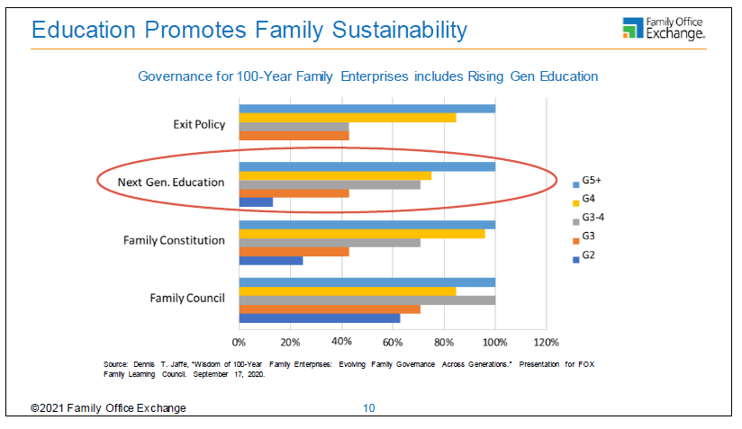
Role of Family Education

Slide 28
Closing Thoughts
Access to this presentation and additional education materials will be provided
Invitation to do an education assessment to determine learning interests and goals
Opportunity for more family dialogue regarding planning considerations
More learning opportunities through Tamarind Learning to follow

